Slide 1
Basic tissue types & cell functional specialization
Dr Hemed El-busaidy

Slide 2
Basic tissue types

Slide 3
Key Terms
Histology:
  the study of tissues.
Tissues:
  groups of cells which are similar in structure and which perform common or related functions.

Slide 4
Four Basic Kinds of Tissues
Epithelial Tissue
Connective Tissue
Muscle Tissue
Nervous Tissue

Slide 5
Epithelial Tissue
Epithelial Tissue Locations:
  Covers the body
  Lines the cavities, tubes, ducts and blood vessels inside the body
  Covers the organs inside body cavities
Epithelial Tissue Functions:
  Protection from physical & chemical injury,
  Protection against microbial invasion,
  Contains receptors which respond to stimuli,
  Filters, secretes & reabsorbs materials and
  Secretes serous fluids to lubricate structures.

Slide 6
Connective Tissue
Connective Tissue:
  Most abundant & widely distributed tissue
Connective Tissue Functions:
  Connects, binds and supports structures,
    Tendons, ligaments, etc.
  Protects & cushions organs and tissues,
  Insulates (fat) and
  Transports substances (blood).

Slide 7
Muscle Tissue
Muscle Tissue:
  Associated with the bones of the skeleton, the heart and in the walls of the hollow organs of the body.
Muscle Tissue Functions:
  Movement/Locomotion
  Maintains posture
  Produces heat
  Facial expressions
  Pumps blood
  Peristalsis

Slide 8
Nervous Tissue
Nervous Tissue:
  Main component of the nervous system,
    ie., brain, spinal cord & nerves.
Nervous Tissue Functions:
  Regulates & controls body functions
  Generates & transmits nerve impulses
  Supports, insulates and protects impulse generating neurons.

Slide 9
Epithelial tissue

Slide 10
Epithelial Types
Simple Epithelium
  Simple squamous – inside blood vessels
  Simple cuboidal – lines ducts, ex. Kidney tubules, mucous glands
  Simple columnar – lining of small intestine
  Pseudostratified Columnar – trachea, bronchi
  STRATIFIED EPITHELIUM

Slide 11
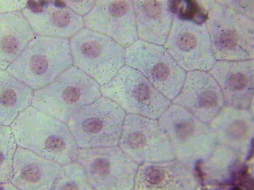
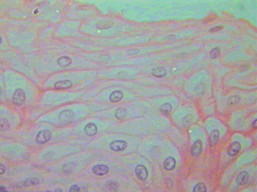
Squamous Epithelium
Simple – one cell thick
Forms solid layer of cells which line blood vessels, body cavities & cover organs in body cavities
Stratified – multiple layers
Forms epidermis

Slide 12
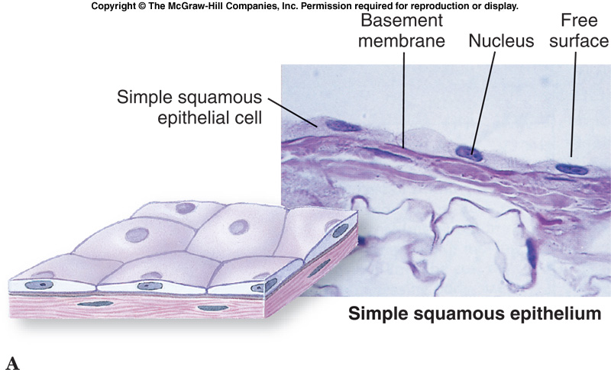
Figure 09.9a

Slide 13
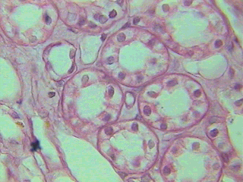
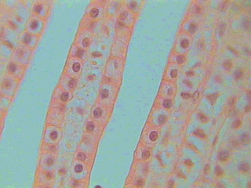
Cuboidal Epithelium
Cuboid Cells
Simple – one cell thick
Roughly cube shaped
Duct
Line ducts in kidneys, etc, where reabsorption and secretory activities take place.
Cuboid Cells
Duct

Slide 14
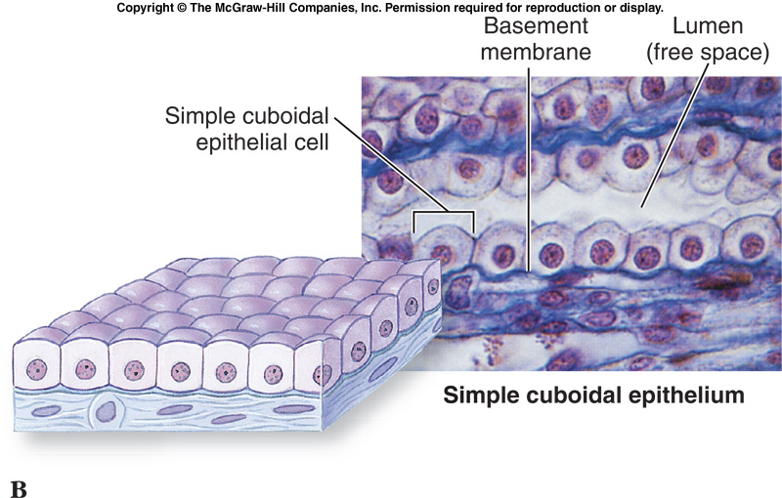
Figure 09.9b

Slide 15
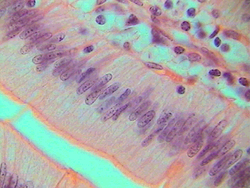
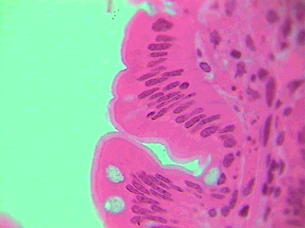
Columnar Epithelium
Simple – one cell thick
Column shaped (long & narrow)
Line digestive tract where reabsorption & secretion occurs.
Pseudostratified – gives the appearance of more than one layer of columnar epithelial cells

Slide 16
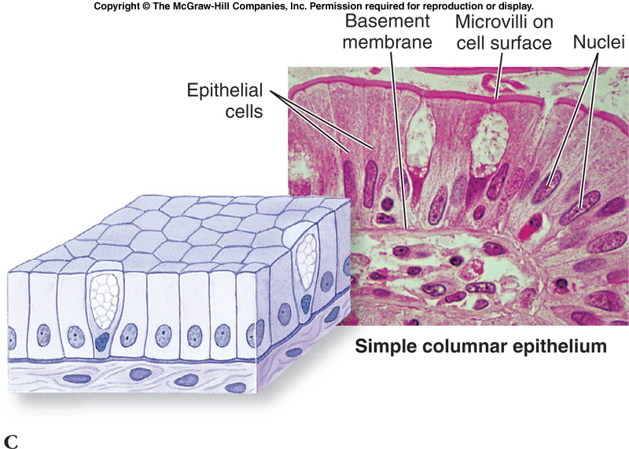

Slide 17
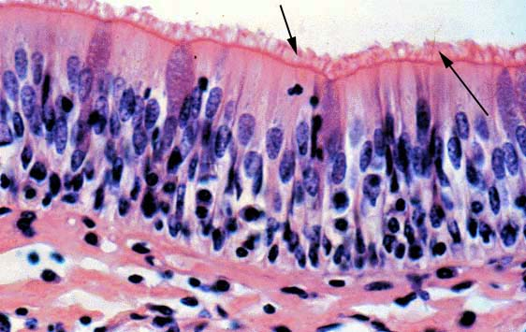
Pseudostratified Columnar

Slide 18
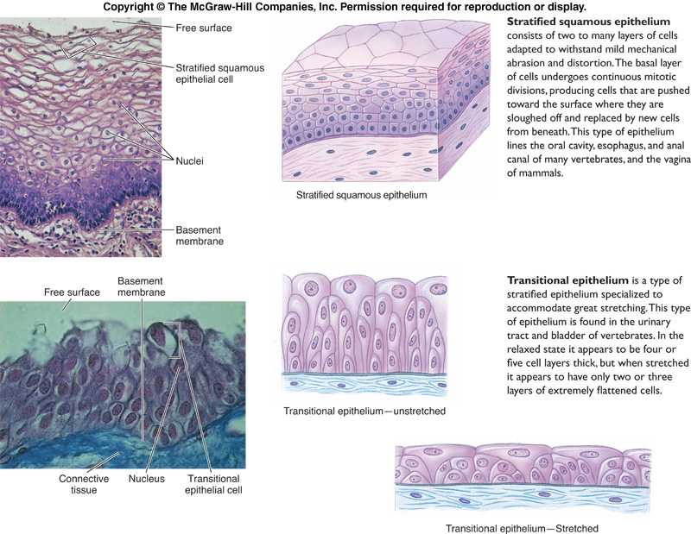

Slide 19
Specific Connective Tissue Types:
    Adipose/fat
    Bone
    cartilage
    Blood/lymph

Slide 20
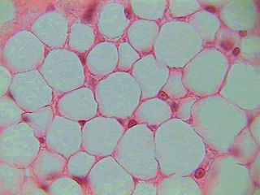
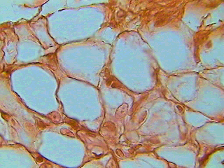
Connective - Adipose
Honeycomb or chickenwire appearance
Stores energy (fat)
Insulates
Supports & protects organs

Slide 21
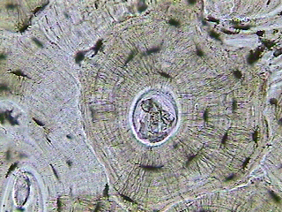
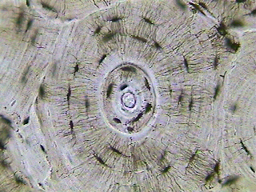
Connective - Bone
Tree ring-like appearance
Supports & protects
Mineral storage
Fat storage
Blood cell production

Slide 22
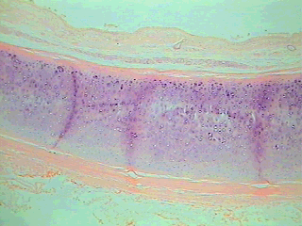
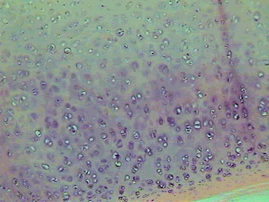
Connective – Hyaline Cartilage
Supports while providing flexibility
Absorbs compression between bones in joints (articular cartilage)
Holds open respiratory passages
Most abundant type of cartilage in body

Slide 23
Specific Muscle Tissue Types:
  muscle (skeletal)

Slide 24
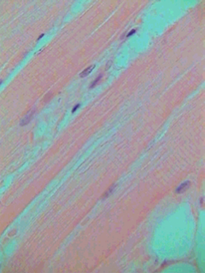
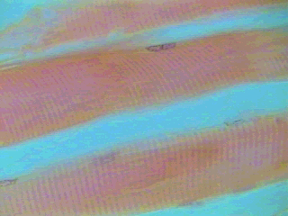
Muscle - Skeletal
Muscle fibers (cells) long, parallel & cylindrical
With many nuclei (multinucleate)
Striations (cross stripes run perpendicular to the cells
Produce voluntary movement
Locomotion
Heat

Slide 25
Cell functional specialization

Slide 26
Protein synthesizing cell
Large euchromatic nucleus
Prominent nucleolus
Abundant RER and ribosomes
Prominent supranuclear golgi apparatus
Abundant mitochondria
Secretory vesicles

Slide 27
Distribution
Liver cells
Muscle cells (all muscles)
Sperm cells
Pancreatic islet cells
Cells of adrenal medulla

Slide 28
Lipid/steroid synthesizing cells
Abundant smooth endoplasmic reticulum
Prominent mitochondria
Lipid droplets
Examples:
Cells of ovary, testis, adrenal cortex

Slide 29
Ion transporting cell
Numerous filamentous mitochondria
Tight junctions/desmosomes
Basement membrane invaginations

Slide 30
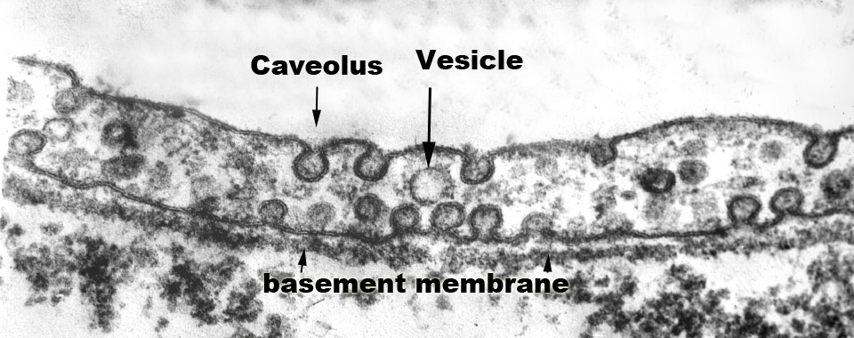

Slide 31
The end

